Slide 1
CHAPTER 2
PREPARING THE BID PACKAGE

Slide 2
제1장 History and Basic Concepts
제2장 Preparing the Bid Package
제3장 Issues During Construction
제4장 Contracts
제5장 Legal Structure
제6장 Impact of Taxes
제7장 Project Planning
제8장 Project Scheduling
제9장 Scheduling: Program Evaluation and Review Technique Networks and Linear Operations
제10장 Resource-Related and Advanced Linear Scheduling Techniques
제11장 The Mathematics of Money
제12장 Project Cash Flow
제13장 Project Funding
제14장 Equipment Ownership
제15장 Equipment Productivity
제16장 Construction Labor
제17장 Estimating Process
제18장 Cost Control
제19장 Materials Management
제20장 Safety

Slide 3
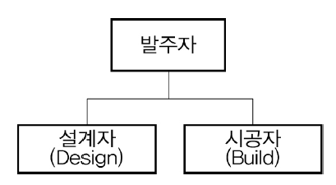
2.1 Project Concept and Need
요구사항 정의
Design/Build 방식
개념설계
개념설계 승인
예비/상세 설계
입찰서류 완료
선정 통보
시공자 선정
제안서 접수
입찰 공고
입찰 결정
시공
준공
FIGURE 2.1 Project development cycle for new project
Private & public projects
Private : Manufacturing plants, hospitals, research laboratories, hotels and commercial buildings, communications networks etc.
public : Bridges, tunnels, transportation facilities, dikes, and dams etc.
수로

Slide 4
2.2 Establishing Need
The first step in any project is the establishment of a need and a conceptual definition and refinement of the facility that will meet that need. 첫번째 단계는 요구사항 정의와 그 요구사항을 충족시키기 위한 시설에 대한 명확한 서술을 마련하는 것
제품수요⋅시장 조사, 타당성분석(Feasibility Study), 비용분석
자금제공자(재무적 투자자)의 요구에 의해 타당성 분석의 내용이 결정: 자금제공자가 사업 타당성에 대한 근거를 요청

Slide 5
2.3 Formal Need Evaluation
Deciding whether or not to proceed with the preliminary and final design
Cost/benefit analysis
Graphical representation of the project (e.g., sketch or artist’s rendering) and a layout diagram of the facility
Cost estimate based on the conceptual-level information available
Benefit
Tangible (직접적인 효과)
Intangible (간접적인 효과)

Slide 6
2.4 Conceptual Drawings and Estimates
Conceptual documentation to potential funding sources (e.g., banks and investors) 잠재적 투자자에게 제공하는 개념적 수준의 문서(기획안)
A cost estimate based on the conceptual drawings and other design information (e.g., square footage of roof area, floor space, size of heating and air-conditioning units, etc.) is prepared. 개념적 설계에 근거한 비용 추정
A projection of cost to the future date on which construction will begin is required. 프로젝트 실행 시점의 돈의 가치로 비용을 추정하는 것이 필요(물가인상률 필요)
The projection is made using the Engineering News-Record (ENR) indexes of basic construction cost.
건설관련 물가인상률 정보 제공

Slide 7
2.4 Conceptual Drawings and Estimates
군 우체국 프로젝트 사례
FIGURE 2.2 Project proposal: layout sketch and outline specification
Military Post Office Project

Slide 8
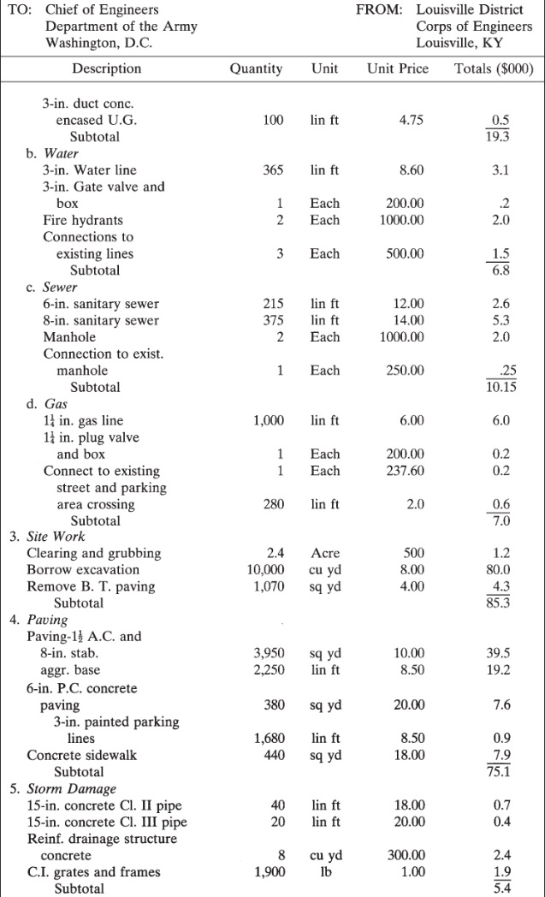
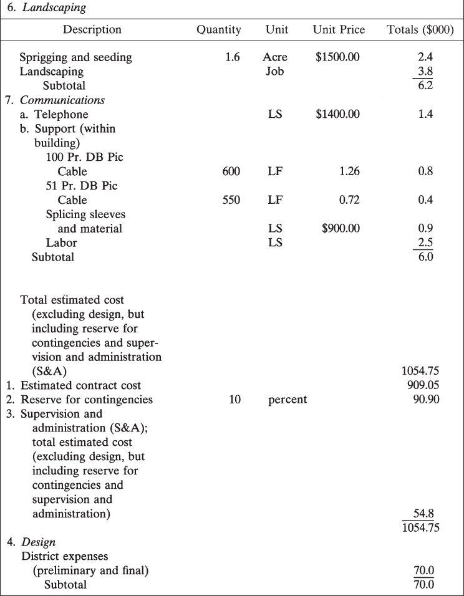
2.4 Conceptual Drawings and Estimates
군 우체국 프로젝트 사례
필요 예산
FIGURE 2.3 Current working estimate for budget purposes

Slide 9
2.4 Conceptual Drawings and Estimates
목재
FIGURE 2.4 Engineering News-Record construction cost indices

Slide 10
2.5 Preliminary and Detail Design
The drawings are a graphical or schematic indication of the work to be accomplished. → 설계도
The specifications are a verbal or word description of what is to be constructed and to what levels of quality. → 시방서
When completed, they are included as legally binding elements of the contract. → 설계도서 : 법적 부속 서류로서 계약에 포함
The design team leader coordinates the efforts of architects and engineers from differing disciplines.
The disciplines normally identified are architectural, civil and structural, mechanical, and electrical.

Slide 11
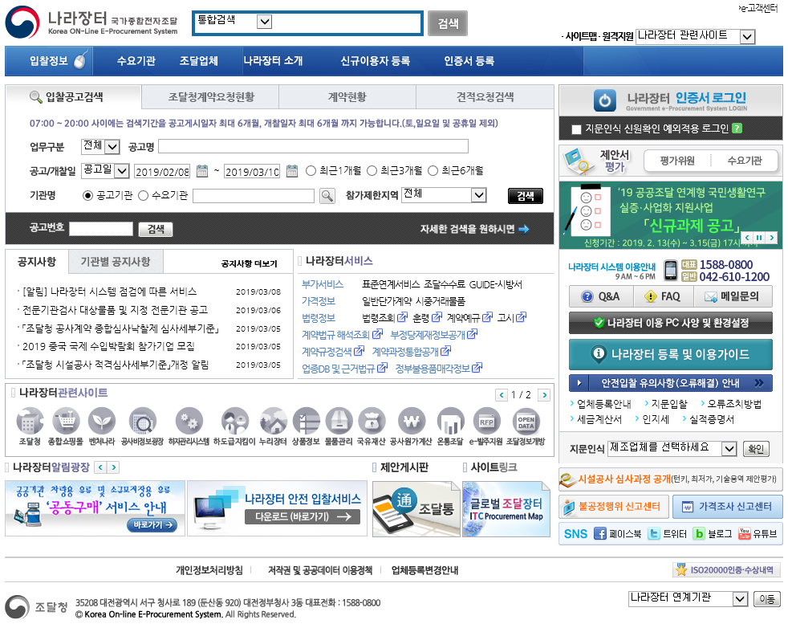
2.6 Notice to Bidders
Because of his commitment to the owner to design a facility that can be constructed within a given budget and at an acceptable level of quality, the architect/engineer wants to be sure that the lowest bid price is achieved. 최저가입찰 ← 예산 제약
입찰 제공 정보 : the general type and size of the project, the availability of plans and specifications for review, and the time, place, and date of the bid opening.
In some large cities, a builder’s exchange may operate to serve the contracting community. → 예) 나라장터를 통한 공공공사 입찰 공고 (FedBizOpps.gov)
Paid services such as Dodge BidPro (©Dodge Data & Analytics) provide detailed information customizable by date, geographic area, type of project, and other customizable parameters. → 유료 입찰 서비스

Slide 12
2.6 Notice to Bidders
병원 하수도 개선 프로젝트 사례
과업 범위
제안서 작성 요령
제안 철회 방법
근로자 급여 책정 : 연방 노동성 기준 적용
입찰 수락 또는 거부 권리 명시
FIGURE 2.5 Typical notice to bidders

Slide 13
2.6 Notice to Bidders
FIGURE 2.6 Example of FedBizOpps.gov available project listing

Slide 14
2.7 Bid Package
The documents that are available to the contractor and on which he must make a decision to bid or not to bid are those in the bid package. 입찰서류를 바탕으로 입찰 참가 여부 결정
In addition to the plans and technical specifications, the bid package prepared by the A/E consists of a proposal form, general conditions that cover procedures common to all construction contracts, and special conditions, which pertain to procedures to be used that are unique to this particular project.
All supporting documents are included by reference in the proposal form.
FIGURE 2.7 Bid package documents

Slide 15
2.7 Bid Package
Bid package → Bid Form → Award of Contract(Notice of Award) → Notice to Proceed
Builder Contractor Builder Contractor
The prices at which the work will be constructed can be stated either as lump-sum or as unit-price figures. 총액 또는 단가 기준 가격 제시
In many instances, the project duration in working or calendar days is specified in the special conditions portion of the bid package. 근무일과 달력일(근문일 + 비근무일) 기준으로 공사기간 제시

Slide 16
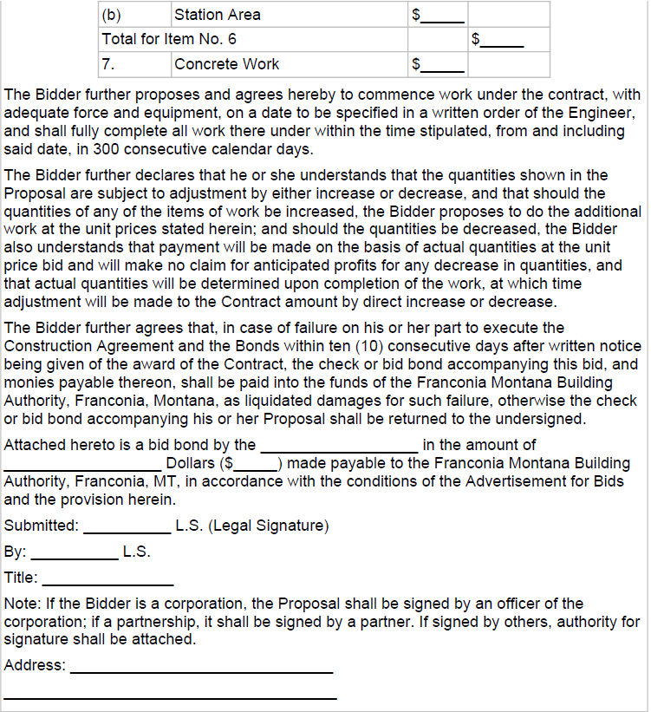
2.7 Bid Package
단가 기준 가격 공사
총액 기준 가격 공사
FIGURE 2.8 Example proposal form

Slide 17
2.8 General Conditions
표준계약문서 제공 위원회 구성 : A committee for engineer documents has been formed jointly by the American Consulting Engineers Council, the National Society of Professional Engineers, and the American Society of Civil Engineers to prepare standard contract documents.
The committee is called the Engineers Joint Contract Documents Committee (EJCDC).
표준계약문서 승인처 : These documents have been endorsed by the Associate General Contractors (AGC) of America and the Construction Specifications Institute (CSI)
권리, 특권, 책임 명시 : The rights, privileges, and responsibilities that accrue to the primary contractual parties in any construction contract are also defined in the general conditions. Therefore, sections pertaining to the (1) owner, (2) architect (or architect/ engineer), (3) contractor, and (4) subcontractors are typically found in the general conditions.
국가를 당사자로 하는 계약에 관한 법률, 시행령, 시행규칙

Slide 18
2.8 General Conditions
American Institute of Architects (AIA)’s general conditions are listed below:
1. Definitions 정의
2. Preliminary matters 기본 사항
3. Contract documents 계약 서류
4. Bonds and insurance 보증 채권 및 보험
5. Contractor’s responsibilities 시공자의 책임
6. Owner’s responsibilities 발주자의 책임
7. Engineer’s responsibilities 설계자의 책임
8. Changes in the work 과업 변경
9. Change of contract price 계약금액 변경
10. Change of contract times 계약기간 변경
11. Test and inspections 시험 및 검사
12. Payments to contractor and completion 공사대금 지불 및 준공조건
13. Suspension of work and termination 작업 중단 및 종료
14. Dispute resolution 분쟁 해결

Slide 19
2.9 Supplementary Conditions
Modifications to the basic articles of the general condition in the form of additions, deletions, or substitutions. 일반 조건에 대한 수정 : 추가, 삭제, 대체
Additional articles of a contractual-legal nature that may be desirable or necessary for a particular project. 법적 성격의 추가 문서

Slide 20
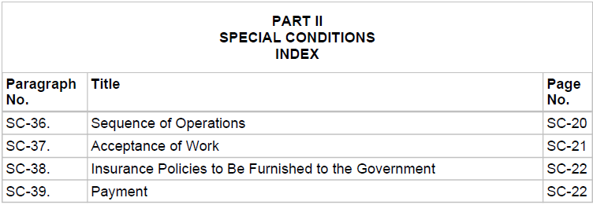
2.9 Supplementary Conditions
FIGURE 2.9 Special conditions: typical index of special conditions

Slide 21
2.10 Technical Specifications
The contract documents must convey the requirements of the project to potential bidders and establish a legally precise picture of the technical aspects of the work to be performed. 계약 시 수행될 과업의 기술적 측면을 정확히 서술할 필요가 있음
This is accomplished visually through the use of drawings. 설계도
A verbal description of the technical requirements is established in the technical specifications. 기술 시방서

Slide 22
2.10 Technical Specifications
A typical index of specifications for a heavy construction project might appear as follows:
1. Clearing and grubbing
2. Removal of existing structures
3. Excavation and fill
4. Sheet steel piling
5. Stone protection
6. Concrete
7. Miscellaneous items of work
8. Metal work fabrication
9. Water supply facilities
10. Painting
11. Seeding
토목공사표준일반시방서
총칙
토공사
구조물 기초공사
콘크리트공사
일반 강구조물공사
방수 및 지수공사
부지시설공사

Slide 23
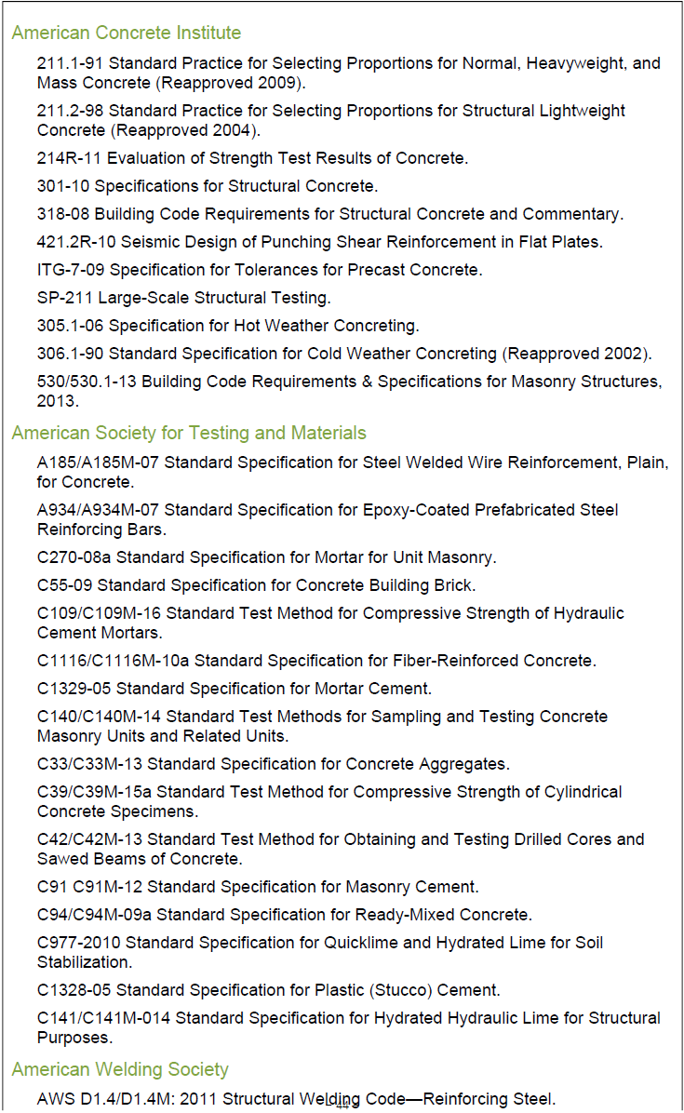
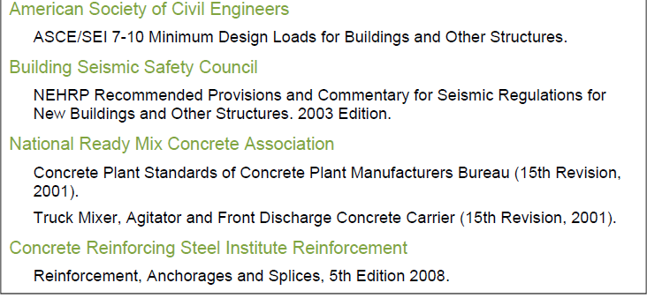
2.10 Technical Specifications
FIGURE 2.10 Typical references to structural inspection and testing standards

Slide 24
참고. 국내 건설공사기준
표준시방서
전문시방서
설계기준
가설공사 표준시방서
강구조공사 표준시방서
건설공사 비탈면 표준시방서
건설환경관리 표준시방서
건축공사 표준시방서
건축기계설비공사 표준시방서
건축전기설비공사 표준시방서
공동구 표준시방서
농업토목공사 표준시방서
도로공사 표준시방서
도로교 표준시방서
도시철도공사(지하철) 표준시방서
산업·환경설비공사 표준시방서
상수도공사 표준시방서
조경공사 표준시방서
콘크리트 표준시방서
터널 표준시방서
토목공사 표준일반시방서
하천공사 표준시방서
항만 및 어항공사 표준시방서
하수관거공사 표준시방서
LH 전문시방서
고속도로공사 전문시방서
농어촌정비공사 전문시방서
댐 및 상수도공사 전문시방서
서울특별시 전문시방서
철도공사 전문시방서
항만 및 어항공사 전문시방서
행복도시건설공사 전문시방서
일반국도 전문시방서
강구조 설계기준
건설공사 비탈면 설계기준
건축 구조기준
건축기계설비 설계기준
건축전기설비 설계기준
공동구 설계기준
구조물기초 설계기준
농업생산기반정비사업계획 설계기준
댐 설계기준
도로 설계기준
도로교 설계기준
상수도 시설기준
조경 설계기준
철도 설계기준
콘크리트 구조기준
터널 설계기준
하수도 시설기준
하천 설계기준·해설
항만 및 어항 설계기준
국토교통부 건설기술정보시스템 http://www.codil.or.kr/
한국건설기술연구원 국가건설기준센터 http://www.kcsc.re.kr/

Slide 25
2.11 Addenda 부록
변경사항 공지
The bid package documents represent a description of the project to be constructed. They also spell out the responsibilities of the various parties to the contract and the manner in which the contract will be administered. 입찰서류 : 프로젝트 서술과 더불어 프로젝트에 관련된 이해당사자들의 책임에 대해 서술
Any changes in detail, additions, corrections, and contract conditions that arise before bids are opened that are intended to become part of the bid package and the basis for bidding are incorporated into the bid package through addenda. 변경사항을 추가된 부록을 통해 공표 → 부록도 법적 효력을 갖는 입찰서류의 일부

Slide 26
2.12 Decision to Bid
Estimating is the process of looking into the future and trying to predict project costs and various resource requirements. 프로젝트 비용 추정
Studies reveal the fact that the most frequent causes of contractor failure are incorrect and unrealistic estimating and bidding practices. 부정확한 비용 추정 → 가장 큰 실패 요인
Quantities of Materials → Direct Cost → Indirect Cost → Management and Overhead Cost → Total Cost
A common rule of thumb states that the contractor’s estimating cost will be approximately 0.25% of the total bid price. 입찰 준비 비용은 프로젝트 비용의 0.25%
만약 평균적으로 4번 중 1번 낙찰이 된다면, 낙찰되는 계약 건에 응찰 시 3번의 비낙찰 시 소요된 비용을 포함하여 견적 제출 → 총 입찰 비용의 1% 만큼을 추가
×4

Slide 27
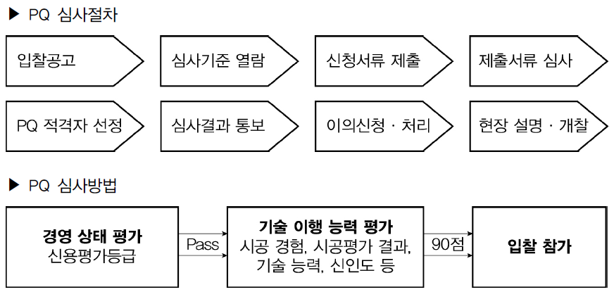
2.13 Prequalification
발주자는 프로젝트를 수행할 능력이 없을 것 같은데 최저가를 제출한 계약자에 대해 고민!
Each contractor interested in preparing and submitting a bid is asked to submit documents that establish his firm’s expertise and capability in accomplishing similar types of construction. 발주자는 시공자에 대해 유사 공사에 대한 시공 사례를 요구

Slide 28
2.14 Subcontractor and Vendor Quotations/Contracts
Prime Contractor 주계약자
Subcontractor(특수 공사 : 터널, 교량, 전기, 기계, 통신 등) + Vendor(자재 공급)
The contractor integrates these quotations from subcontractor and vendors into the total bid price. 주계약자는 하도급자와 자재공급자의 견적을 종합하여 입찰에 응함

Slide 29
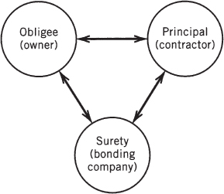
2.15 Bid Bond 입찰보증금 : 낙찰자 계약 체결 거부 대비
A construction bond, therefore, involves a relationship between three parties: the principal or party who might default, the obligee or party who may be damaged or lose some advantage, and the surety who will offset the damage or loss of advantage. 발주자, 시공자, 보증자 사이의 손해 발생가능성을 대비한 보증 체계
만약 어떤 Contractor가 $3,000,000에 낙찰 받은 후 이행을 포기하여, 차 순위자인 $3,080,000에 응찰한 Contractor에게 낙찰되었다면, 발주자의 손해액 $80,000을 입찰보증금에서 충당. 입찰보증금은 통상 공사금액의 5% 수준.
보증금
FIGURE 2.11 Bonding relationship (three-party)

Slide 30
2.16 Performance and Payments Bonds
If the contractor is awarded the contract, performance and payment bonds are issued.
A performance bond (이행보증금: 낙찰자 공사 수행 거부 대비: Owner & Contractor) is issued to a contractor to guarantee the owner that the contract work will be completed and that it will comply with project specifications. Contractor → 이행보증금 → Owner
In other words, a performance bond protects the owner against default on the part of the contractor in performing the project as required.
A payment bond (지불보증금: 주계약자의 공사대금 지불 불능 상황 대비: Prime Contractor & Subcontractor, Vendor) is issued to guarantee the owner protection against any liens or charges against the project that are unpaid as a result of the contractor’s default. Prime Contractor → 지불보증금 → Subcontractor, Vendor
Contractor 파산 시 Subcontractor와 Vendor에게 대금 지급용으로 사용, Contractor 유동성 위기 시 자금 지원
보증사는 해결사(Troubleshooters) DB를 보유 → 문제 발생 시 해결사를 즉시 투입하여 공사가 계속될 수 있도록 조치를 취해 Owner를 보호

Slide 31
2.17 Cost and Requirements for Bonds
Performance and payment bonds are issued for a service charge. The common rate is 1% or $10 per $1,000 on the first $200,000 of contract cost. At higher contract costs, the rate is reduced incrementally.
보증보험 회사는 이행보증금 집행 시 보험 가입자 및 관계자에게 구상권을 청구한다.
The Miller Act (enacted in 1935) establishes the level of bonding required for federally funded projects. Performance bonds(이행보증금) must cover 100% of the contractor amount while payment bonds(지불보증금) are required based on a sliding scale as follows:
1. 50% if the contract is $1 million or less 전체 공사 금액의 50%를 커버할 수 있는 보증보험 요구
2. 40% if the contract is between $1 and $5 million
3. Fixed amount of $2.5 million if the contract is greater than $5 million

