Slide 1
CHAPTER 6
IMPACT OF TAXES

Slide 2
제1장 History and Basic Concepts
제2장 Preparing the Bid Package
제3장 Issues During Construction
제4장 Contracts
제5장 Legal Structure
제6장 Impact of Taxes
제7장 Project Planning
제8장 Project Scheduling
제9장 Scheduling: Program Evaluation and Review Technique Networks and Linear Operations
제10장 Resource-Related and Advanced Linear Scheduling Techniques
제11장 The Mathematics of Money
제12장 Project Cash Flow
제13장 Project Funding
제14장 Equipment Ownership
제15장 Equipment Productivity
제16장 Construction Labor
제17장 Estimating Process
제18장 Cost Control
제19장 Materials Management
제20장 Safety

Slide 3
6.1 Society and Taxation
One of the first documented tax systems was implemented in ancient Egypt. Farmers paid their taxes in kind to scribes appointed as tax collectors. The tax owed was determined in proportion to the area and location of the farm. 이집트 - 최초의 세금 기록, 농민들이 농지 경작 면적에 따라 세금 납부
Citizens were able to pay their taxes by performing corveé duty (부역 의무), which consisted of working in public works (such as the Pharaoh’s burial monument) 시민들은 부역 의무를 가짐 : 스핑크스나 피라미드 건설 부역
FIGURE 6.1 The Sphinx and Pyramid II

Slide 4
6.2 Business Impact of Taxation
The profitability of any construction company is significantly affected by the amount of taxes it is required to pay. 수익성은 납입해야 할 세금의 액수에 영향을 받음
Conceptual outline of the U.S. tax system.

Slide 5
6.3 Why Taxes?
Taxes are primarily designed to finance government operations and to meet societal needs. 정부 운영 재정 마련을 위해, 사회적 요구사항을 충족시키기 위해, 세금 필요
재원 마련 및 캠페인 목적 (고율의 담배세, 기부금 공제 등)

Slide 6
6.4 Types of Taxes
A tax levied on the net income realized by a company or individual is called an income tax. 개인이나 법인의 소득에 부과되는 세금 : 종합소득세, 법인세
Income taxes are referred to as direct taxes. 직접세 : 소득이나 재산에 직접 부과되는 세금 (ex. 소득세, 재산세)
Indirect taxes, in contrast, are levied on the cost, price, or value of products or services (e.g., sales tax) 간접세 : 제품이나 서비스에 부과되는 세금 (ex. 부가가치세)
Tax deductions 세금 공제(연금, 보험, 교육비, 의료비 공제 등)

Slide 7
6.5 Income Tax Systems
The corporate form of legal organization leads to double taxation because the corporation is taxed as a business entity and the stockholders are taxed separately as individuals for profits distributed to them as dividends.
이중과세 = 법인세 + 배당금 소득세 (법인의 국내원천소득 중 배당소득에 대한 이중과세에 대해 개인주주의 경우 Gross-up 제도, 법인주주의 경우 수입배당금 익금불산입제도를 두어 이중과세를 조정 → 법인의 소득에서 배당금 소득세 과세 부분의 배당금을 공제)
Income = Revenue – Expenses 소득 = 매출 – 비용
Taxable Income = Revenue – Expenses – Deductions
과세소득 = 매출 – 비용 – 공제 = 소득 – 공제

Slide 8
6.6 Taxation of Businesses (1/2)
In business organizations, the definition of revenues and expenses becomes more important and must conform to guidelines established by tax law. 매출과 비용의 정의 필요
Revenue is, in effect, the summation of all amounts due and payable to a company from clients or other financial sources for work performed, sales and services supplied, and other financial transactions. 매출: 판매액(기성)
Direct expenses: These expenses are incurred in operations that lead to the realization of the physical facility being constructed. Typical direct expenses are job payroll, project related equipment costs, the cost of materials used for construction of the project, and subcontractor payments. 직접비: 인건비, 장비비, 자재비, 하도급
Indirect expenses: This term relates to costs incurred for the management support of the job site and for home office general and administrative costs (e.g., senior management and staff salaries, office equipment costs such as computer and copying charges, and costs related to the ownership or rental of office space). These types of indirect expenses are often referred to as “overhead” or “overhead expenses.” 간접비: 본사 임직원 인건비, 사무실 운영비, 사무실 임대료 등 경비

Slide 9
6.6 Taxation of Businesses (2/2)
매출
직접비
이익
완전(전액) 공제 불가
감가상각
경비
세전이익
세금
(세후이익)순익
FIGURE 6.2 Income Statement for Fudd Construction Co., 3rd Qtr, 2XXX

Slide 10
6.7 Business Deductions in General
Most firms try to reduce their amount of taxable income as much as legally possible. 모든 기업은 과세 대상 소득을 줄이고자 함
Deductions allow companies to reduce the amount of income subject to taxation. 소득공제 (과세 대상 소득 : 소득 – 공제)
Probably the most significant deduction available to construction contractors is that given for the loss in value of company equipment over time → Depreciation. 건설 기업에 있어서 가장 큰 비중을 차지하는 공제 항목 : 보유 장비의 가치 하락에 따른 감가상각

Slide 11
6.8 Taxable Income: Individuals
For tax purposes, individuals are classified into the following filing statuses: 납세자 유형
Single: Unmarried individual generally pay the highest amounts of tax compared to the other categories. 미혼 개인 : 일반적으로 다른 유형보다 더 많은 세금 납부
Married filing separately: A married couple may decide to pay taxes separately, filing their tax returns as essentially two single individuals. 결혼 개별 : 고액 연봉자들이 선호, 개인으로 세금을 내는 것 보다는 경제적
Married filing jointly: This filing status comprises the traditional married couple and children, choosing to use a single tax return for the couple and dependents. 결혼 합산 : 부부 또는 가족으로 합산하여 세금 납부
Head of household: This is the one category that is given some tax benefits: single parents, single children supporting their parents, and similar individuals frequently under financial duress. 세대주 : 미혼모, 미혼부 등 재정 압박을 받고 있는 개인들

Slide 12
6.9 Itemized Deductions, Standard Deductions, and Personal Exemptions (1/2)
Every individual (or family, if filing jointly) can deduct certain items from their income, thus reducing the tax basis on which their taxes will be computed. Contributions to charity, medical expenses over a certain threshold, the interest paid on the mortgage loan for the individual’s residence, and other deductions can add up to a substantial amount of money. 소득 공제: 기부금, 의료비, 주택대출상환이자 등
One of the most important deductions available to construction contractors is the depreciation of property. 건설사업자: 감가상각 공제가 중요
This item-by-item reporting is called the itemized deduction approach. 개별 공제 : 개별 항목별로 공제를 받음
Alternatively, individuals can choose to subtract a standard deduction from their income instead of performing an itemized deduction calculation. 표준 공제 : 개별 항목별로 공제액을 계산하지 않고, 유형별 표준 공제액을 공제 받음 → 일종의 유형별 평균 공제 금액 개념

Slide 13
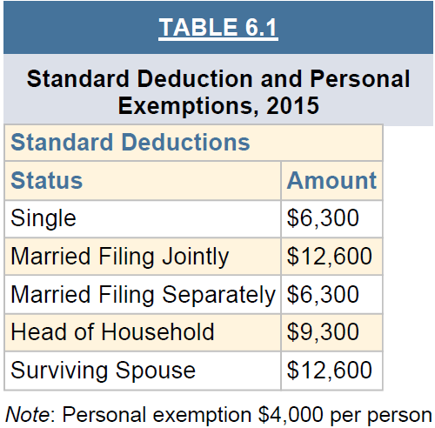
6.9 Itemized Deductions, Standard Deductions, and Personal Exemptions (2/2)
생존 배우자
인당 세금 공제액(기초공제)

Slide 14
6.10 The Tax Significance of Depreciation 감가상각의 중요성
Depreciation reflects the loss of value and obsolescence of property (e.g., equipment) involved in the operation of a business. 감가상각은 장비 등 자산의 가치 하락을 반영
Depreciation applies to all property required for the operation of a business. 사업 수행을 위해 필요한 모든 자산에 감가상각 적용
Computers, office furniture, heavy equipment, and real estate are all depreciable assets. 감각상각 가능 자산 : 컴퓨터, 가구, 중장비, 부동산 등

Slide 15
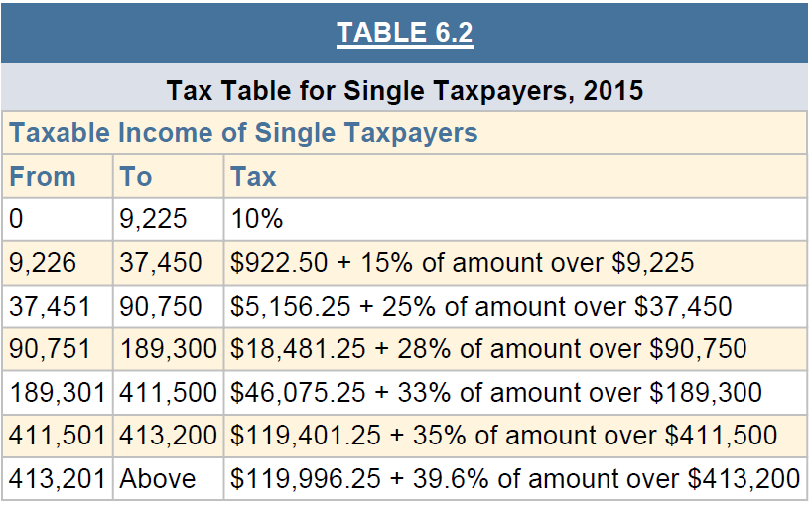
6.11 Marginal Tax Rates (1/3)
The income tax depends on two main factors: the filing status of the taxpayer (i.e., corporation, single individual, married filing jointly, etc.), and the taxable income on which the tax is computed. 세율은 납세자의 유형과 과세소득 수준에 따라 상이함
미혼개인 소득세율
우리나라 : 6% ~ 42%

Slide 16
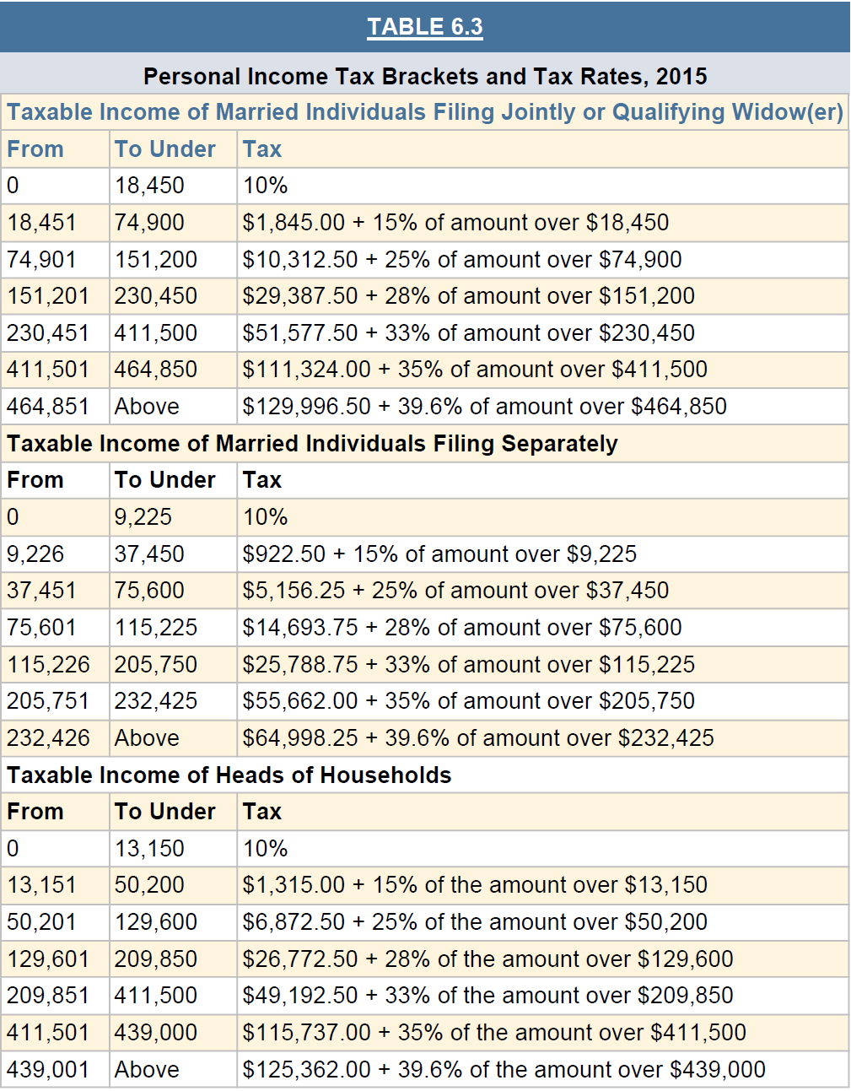
6.11 Marginal Tax Rates (2/3)

Slide 17
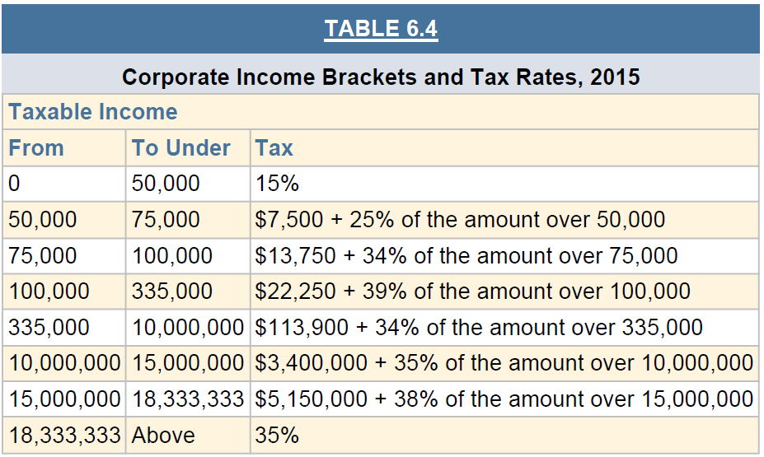
6.11 Marginal Tax Rates (3/3)
법인 소득세율
우리나라 : 10% ~ 25%

Slide 18
6.12 Tax Credits
A tax credit (세액공제) is an allowance that can be deducted from the tax as computed in the previous section (Deduction : 소득공제), instead of from the individual’s or corporation’s taxable income.
It must be repeated that credits are subtracted from the computed tax and not from the income. 세액공제는 소득이 아닌 세금에서 차감

Slide 19
6.13 Tax Payroll Withholding 임금 소득자 원천징수
Employers are required to retain an amount from each paycheck that is roughly enough to cover the employee’s projected tax liability at the end of the year. 임금 소득자 → 소득세 선납입 후정산
It is possible that the total amount withheld exceeds the total tax owed, in which case the IRS refunds the amount of overpayment to the individual taxpayer 임금 소득자 → 소득세 연말정산을 통해 과납분/미납분 세금 정산

Slide 20
6.14 Tax Payment Schedules
Corporations and some individuals must pay their taxes in quarterly installments (분할 납입금) (roughly every three months). 분기마다 소득세 납부
This avoids the shock of paying a single large balloon payment at the end of the tax period. 분기마다 소득세를 정산함으로써, 연말정산금액 변동성을 최소화
First three installments (15th of April, June, and September) but pay the last installment on January 15th of the following year. 세금 납부일 : 4, 6, 9, 1월 15일

Slide 21
6.15 Marginal, Average, and Effective Tax Rates
The average tax rate (평균세율: 우리가 알고 있는 세율) compares the tax paid to the taxable income:
Average Tax Rate = Tax Paid / Taxable Income 분모 : 과세 소득
The effective tax rate (유효세율: 감춰진 세율) is the ratio between tax paid and income prior to subtraction of deductions and exemptions: 세액공제와 소득공제로 인해 세율 감소
Effective Tax Rate = Tax Paid / Gross Income 분모 : 전체 소득

Slide 22
6.16 Summary
This chapter has discussed issues related to taxation that influence the bottom line of a construction company and impact financial decisions.
The company’s top management and particularly the chief financial officer (CFO) must continuously study and analyze the impact of taxation on all financial and organizational decisions. 세금 관리 : 최고회계관리자의 역할

