Slide 1
CHAPTER 10
RESOURCE-RELATED AND ADVANCED LINEAR
SCHEDULING TECHNIQUES

Slide 2
제1장 History and Basic Concepts
제2장 Preparing the Bid Package
제3장 Issues During Construction
제4장 Contracts
제5장 Legal Structure
제6장 Impact of Taxes
제7장 Project Planning
제8장 Project Scheduling
제9장 Scheduling: Program Evaluation and Review Technique Networks and Linear Operations
제10장 Resource-Related and Advanced Linear Scheduling Techniques
제11장 The Mathematics of Money
제12장 Project Cash Flow
제13장 Project Funding
제14장 Equipment Ownership
제15장 Equipment Productivity
제16장 Construction Labor
제17장 Estimating Process
제18장 Cost Control
제19장 Materials Management
제20장 Safety

Slide 3
10.1 Resource Scheduling
The term resources in construction planning and scheduling can refer to the “triplet” of materials, labor (i.e., workers), or equipment, or even crews, which are combinations of equipment with their operators. 건설 계획 분야의 자원: 자재, 인력, 장비
It is necessary to carefully consider resources when developing a realistic schedule. 실행 가능한 일정계획 수립을 위해서는 자원을 고려하는 것이 중요함
Resource allocation to adhere to a given availability. 자원 할당: 자원 → 공정
Resource leveling to improve the workflow. 자원 부하 균형화: 공사 기간 중 필요 자원의 수를 가능한 한 일정하게 유지

Slide 4
10.2 Resource Allocation
주공정선 A-C-E-G-I
프로젝트 공기(자원 제약이 없는 경우): 2+1+4+4+2 = 13
자원 제약이 없으면 13일에 완성 가능
자원 제약으로 인해 16일에 완성
2일 지연
1일 지연
필요한 자원의 수
가용 자원
FIGURE 10.1 Example 1: Resource allocation to minimize project duration

Slide 5
10.3 Resource Leveling
부공정(여유 O) : 이동 가능 → 조정
주공정(여유 X) : 이동 불가 → Fix
자원 : 6대 필요
자원 : 4대면 충분
FIGURE 10.2 Example 2: Resource leveling to optimize labor assignment
(Heuristics: Rule of thumb)

Slide 6
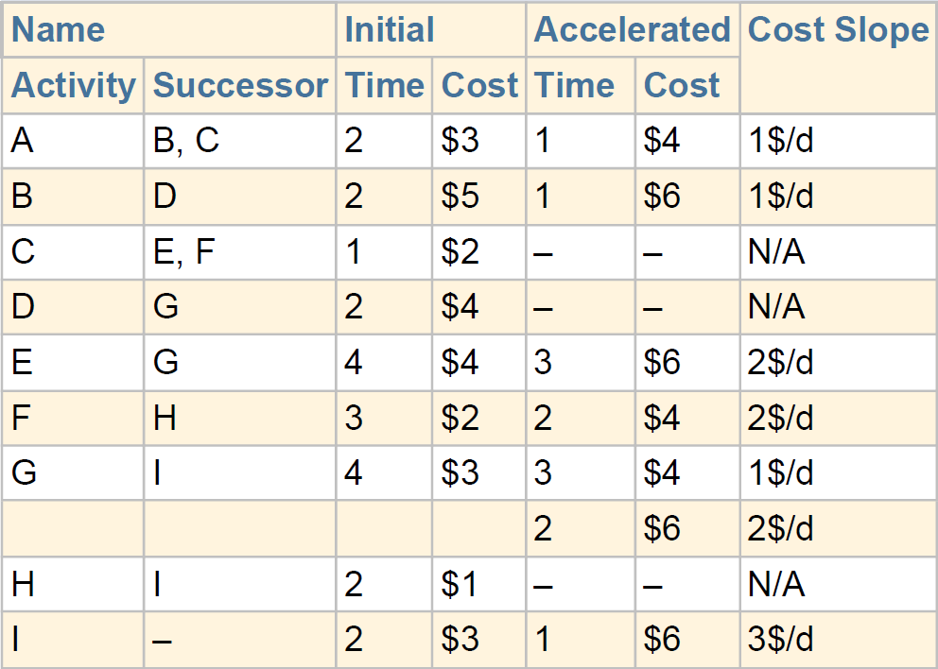
10.4 Time–Cost Trade-off
Normal vs. Accelerated
$27 for 13 days vs. 8 days at $36
Time, cost, and the scope of work (with its quality requirements) are related in what has become known as the “triple constraint” or “iron triangle” in project management to indicate their close relationship.
Trade-off between the duration of a project and its cost must be analyzed 공기 vs 공사비
The initial duration and cost, and the accelerated (crashed) duration and cost.
Slope
정상 공기
특급 공기
비용 구배
부공정 → 주공정
주공정
FIGURE 10.3 Example 1: Time–cost trade-off curve

Slide 7
10.5 Linear and Repetitive Scheduling Techniques
From cost estimating five basic types of measures are familiar: length, area, volume, weight, and count 공사 진도 체크 단위 : 길이, 면적, 부피, 무게, 개수
Length of road that has to be paved 도로의 길이
Weight of steel that must be erected 세워질 철골의 무게
The number of faucets that are installed 설치될 수전의 개수
More generic measures that can always be applied to any type of work: 일반적 단위
Monetary value (in dollars) 금액으로 환산된 진도
Percent complete at a particular time 준공률
Construction projects are mostly horizontally linear (e.g., roads, tunnels, and bridges), vertically linear (e.g., high-rise buildings) 건설 진도는 수평적으로 또는 수직적으로 선형성을 띰

Slide 8
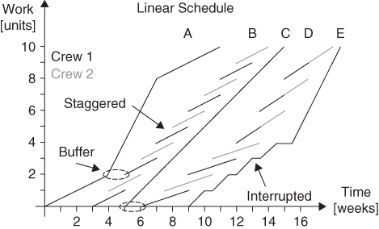
10.6 Linear Scheduling Method (1/2)
Linear scheduling has been developed for project control since the early 20th century.
The linear scheduling method (LSM) resembles the first of the three LOB charts, but can show significantly more details. LSM은 Objective Chart(Production Curve)와 유사하지만 좀더 다양한 정보를 제공함
Activities
A, C, E: single crew
시차를 두고 작업
E: 간섭을 받아 늦춰졌다가 가속하여 진행
A와 B사이의
여유시간
수평선 : 작업 중단을 의미 : 간섭으로 인한 지연
B와 C사이의
여유시간
FIGURE 10.4 Linear scheduling method (LSM)

Slide 9
10.6 Linear Scheduling Method (2/2)
Line-of balance quantity (LOBQ) chart and was introduced by Lumsden (1968), but is not found in the original U.S.
Each activity is represented with one diagonal line (unless interrupted) in the LSM chart, but with two enveloping lines in LOBQ. Buffer(여유)와 Delay(지연)의 명확한 표시
A, C, E: single crew
B, D : Two crews
빈 공간
Buffer
기울어진 점선
간섭으로 인한 지연
FIGURE 10.5 Line-of-balance quantity (LOBQ)

Slide 10
10.6 Linear Scheduling Method (2/2)
Line-of balance quantity (LOBQ) chart and was introduced by Lumsden (1968), but is not found in the original U.S.
Each activity is represented with one diagonal line (unless interrupted) in the LSM chart, but with two enveloping lines in LOBQ. Buffer(여유)와 Delay(지연)의 명확한 표시
A, C, E: single crew
B, D : Two crews
빈 공간
Buffer
기울어진 점선
간섭으로 인한 지연
FIGURE 10.5 Line-of-balance quantity (LOBQ)

Slide 11
10.7 Case Study of a Linear Project (1/4)
Consider the example of a 10-floor office building for which we will create a linear schedule.
The building has two levels of underground parking and mechanical and cooling equipment in a roof penthouse for a total of 13 levels. 지하 2층, 지상 10층, 펜트하우스: 총 13층
LF = Linear Foot (대략 30cm)
FIGURE 10.6 Schematic elevation and footprint

Slide 12
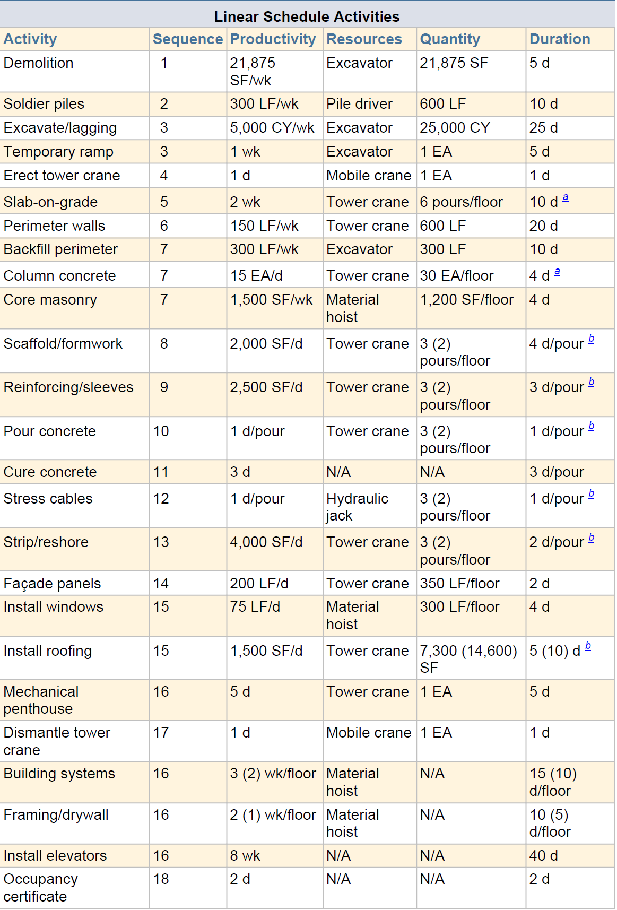
10.7 Case Study of a Linear Project (2/4)
two levels of underground
10-floor office building
roof penthouse
공통

Slide 13
10.7 Case Study of a Linear Project (3/4)
FIGURE 10.7 Linear schedule for case study project

Slide 14
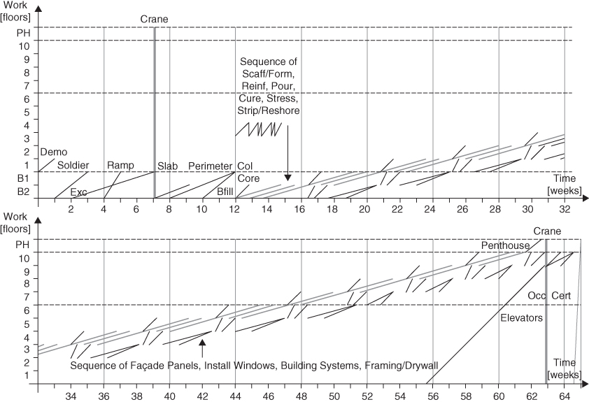
10.7 Case Study of a Linear Project (4/4)
기초 공사
13층 공사
공통 공사
FIGURE 10.7 Linear schedule for case study project

