Slide 1
CHAPTER 11
THE MATHEMATICS OF MONEY

Slide 2
제1장 History and Basic Concepts
제2장 Preparing the Bid Package
제3장 Issues During Construction
제4장 Contracts
제5장 Legal Structure
제6장 Impact of Taxes
제7장 Project Planning
제8장 Project Scheduling
제9장 Scheduling: Program Evaluation and Review Technique Networks and Linear Operations
제10장 Resource-Related and Advanced Linear Scheduling Techniques
제11장 The Mathematics of Money
제12장 Project Cash Flow
제13장 Project Funding
제14장 Equipment Ownership
제15장 Equipment Productivity
제16장 Construction Labor
제17장 Estimating Process
제18장 Cost Control
제19장 Materials Management
제20장 Safety

Slide 3
11.1 Introduction
Management of money is critical to the success of any company. 기업 경영의 성공을 위해서는 자금관리가 매우 중요
Inventory financing: 선투입 → 후정산 → 항상 자금이 필요함 → 자금 조달 문제가 발생함
When money is borrowed, the lender will require a fee for the use of the borrowed funds. This fee is called the loan’s interest. 이자 : 차입금에 대한 사용료 개념
Engineering Economics: 공학경제 or 경제성공학

Slide 4
11.2 Time Value of Money
Time Value of Money (TVM): One dollar available right now is more attractive than one dollar offered to be available at a future time. 돈의 시간적 가치 : 현재 시점의 돈의 가치는 미래 시점의 같은 금액의 가치보다 크다
Any decision involving the acquisition or payment of money over time must consider TVM. 장 기간에 걸쳐 돈의 흐름이 발생하는 프로젝트에 대한 경제성 분석 시 반드시 돈의 시간적 가치를 고려해야 함.

Slide 5
11.3 Factors Determining the Time Value of Money
Three factors must be considered to analyze the value of money over time: 돈의 시간적 가치에 따른 미래가치 결정 요소
The amount’s principal, which is the value of the investment at present time. 원금
The interest rate, that is, the interest over a unit of time. This rate is expressed as a percentage. 이자율
The time involved. 기간 (현재와 미래와의 시점 차이)
Many factors influence the interest rate charged by a lender. 이자율 결정 요소
The degree of investment risk 프로젝트에 대한 투자 위험
The creditworthiness of the borrower 채무자의 신용도
The inflation rate 물가상승률
The stability of the market where the money will be used 시장 안정성
The level of competition among lenders 대출자 간의 경쟁
The cost of the money to the lender. 대출자의 자금 조달 비용

Slide 6
11.4 Simple and Compound Interest
There are two fundamentally different ways to compute interest. 두가지 이자 계산 방법
Total interest depends on the type of interest: whether it is simple or compound. 단순이자 vs 복합이자(복리)

Slide 7
11.4.1 Simple Interest
Paying simple interest means that you pay interest on the principal, but not on the interest accumulated from previous periods. 원금에만 이자가 붙는다.
The future value F_{n} of a principal P borrowed over n periods at an interest rate i can be computed as F_{n} = P × [1 + in], F_{n}(n기 후의 미래가치), P(현재가치), n(기간), i(이자율)
이자율 i = 10%

Slide 8
11.4.2 Compound Interest
When using compound interest, the interest owed after each time period is computed by adding the interest accumulated from previous periods to the loan principal, and then multiplying this total by the interest rate. 원금과 축적된 이자 모두에 이자가 붙는다.
The future value F_{n} of a principal P borrowed over n periods at an interest rate i can be computed as F_{n} = P × (1 + i)^{n}, F_{n}(n기 후의 미래가치), P(현재가치), n(기간), i(이자율)
이자율 i = 10%

Slide 9
11.5 Nominal and Effective Rate
Annual Percentage Rate (APR) : lenders clearly indicate interest rates as an annual percentage of each received dollar. 소비자 보호를 위해 1년 단위의 명목 이자율을 공시토록 함.
It is possible to find the effective annual rate that you pay on a loan (usually called its Annual Percentage Yield or APY) if you know its APR and the number of times per year that the interest is compounded. 1년에 이자를 몇 번 따져주는가에 따라 실효 이자율이 결정됨.
연복리(12%, 1번/년)
월복리(1%, 12번/년)

Slide 10
11.6 Equivalence and Minimum Attractive Rate of Return
Equivalence (경제적 등가) is usually considered in terms of interest rates instead of total interest. 경제적 등가는 총 이자가 아닌 이자율로 표현
If a person or company considers it equally attractive to have $100 now or to get $150 a year from now, the interest rate that this person considers equivalent would $50/$100 = 50%. $100를 꿔주고 1년 후에 $150을 돌려 받는다면, 이 거래는 이자율 50%에서 경제적 등가임 (이 거래는 이자가 $50인 경우 경제적 등가임)
This particular interest rate is called the minimum attractive rate of return (MARR) (최소요구수익률) for that person or company. 투자를 위한 최소한의 기대 수익률 → 현재가치, 연등가, 미래가치 등을 구하는 경제성분석을 위한 이자율

Slide 11
11.7 Discount Rate
What we have called so far interest rate is sometimes called discount rate. 이자율은 종종 할인율로 불림
When the value in the future of a given sum is known and what is required to know is its equivalent value now, the amount F is discounted to find its present value P. 미래가치를 할인하여 현재가치를 구함
P = F_{n}/(1 + i)^{n}, F_{n}(n기 후의 미래가치), P(현재가치), n(기간), i(이자율)

Slide 12
11.8 Sunk Costs
Any cost that has already been expended is called a sunk cost (매몰비용). 의사결정 전에 이미 지출된 비용 → 예: 건설이 중단된 건물에 대해 지금까지 투자된 비용
As such, it cannot be revoked and, therefore, is irrelevant to future decisions. 매몰비용은 미래 의사결정에 영향을 끼치지 못함 → 분석에 포함시키지 않음
You purchased a new computer two months ago for $2,000. However, a new model with the same features is available now for $1,000. If you are offered $1,200 for the old computer, should you sell the old computer and purchase the new model? Yes : $200 profit. 두 달 전에 $2,000을 주고 컴퓨터 구입, 현재는 동일한 컴퓨터를 $1,000에 구입 가능, 구입한 컴퓨터를 $1,200에 팔 기회가 있다면 팔아야 할까? 팔면 $200 이득? or $800 손해?
의사결정 시 지나간 일은 모두 무시 → 현재의 상황만 중요 → 기존 컴퓨터 팔아서 + $1,200, 새 컴퓨터 구입하는데 - $1,000 → $200 이득, “$2,000을 주고 산 컴퓨터인데 $1,200을 주고 파니 $800이 손해네!” ← 이런 생각은 의미가 없음.
10,000원을 주고 산 주식이 8,000원이 되었다. 이 주식을 보유해야 하는가? → 현재 8,000원이 있다면 그 주식을 사겠는가? 이 질문만이 의미가 있다. 예전에 10,000원이었다는 사실은 의사결정에 아무런 영향을 미치지 못한다.

Slide 13
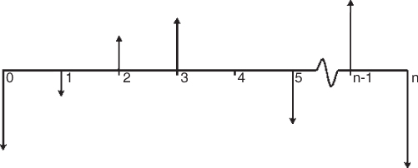
11.9 Cash Flow Diagrams
Cash flow diagrams provide a graphical means for describing situations in which interest and time interact. 현금흐름도: 프로젝트 자금 흐름을 시각적으로 나타냄
Developing the appropriate cash flow diagram is often the critical step in solving an engineering economy analysis. 현금흐름도 작성은 경제성 분석의 출발점
Specifically, it consists of the following:
A timeline consisting of a horizontal line 가로축은 시간
Arrows placed on the tick marks show each sum of money. An inflow of money is shown as an arrow pointing up at the point the money or value of an asset was earned; similarly, the arrow for a money outflow is drawn pointing down. 현금 유입은 위쪽 화살표, 현금 유출은 아래쪽 화살표
Comments and additional data are written near the main timeline and arrows. 주석
FIGURE 11.1 Structure of a cash flow diagram

Slide 14
11.10 Annuities
An annuity (연등가) is a series of equal payments paid out or received in a sequence over a period of time. → uniform payment series 연등가: 매 기간 일정한 현금흐름
예: 대출 상환액 또는 정기 적금액 등
FIGURE 11.2 Standard and defective annuity schemes

Slide 15
11.11.1 Present Value of an Annuity: Finding P Given A
The present value P of an annuity A is the amount of money that is equivalent to the entire flow of payments considering an interest rate of i over n time periods. To find P given A, n, and i the following formula is applied:
As an example, 36 monthly payments of $968 each at an APR of 10% compounded monthly will have the following present value (i = APR/12 months = 0.8333%/month)
P

Slide 16
11.11.2 Installments Paying for an Item: Finding A Given P
The formula to convert P to A can be written as follows, which is the inverse of the formula for finding A giving P discussed in the previous section:
For an item selling at $30,000 at i = 0.008333%/month and n = 36 months, the A to P formula is applied as follows: 할부, 대출

Slide 17
11.12 Future Value of a Series of Payments: Finding F Given A
The formula to apply here, where the objective is to find F given n payments of A dollars each at an interest rate of i is
매달 $1,000씩 10% 이율로 20년을 적립하는 경우,
FIGURE 11.3 Future value of an annuity

Slide 18
11.13 Annuity Required to Reach a Goal Amount: Finding A Given F
A person may want to know how much to save every month to reach a given bank account balance after n years by a bank that offers an interest rate of i. The scenario can be described as finding A given F over n periods at an interest rate of i. The formula used in this case is
As an example, to find the annual payment that would result in a balance of $500,000 after 20 years at 10%:
A
F

Slide 19
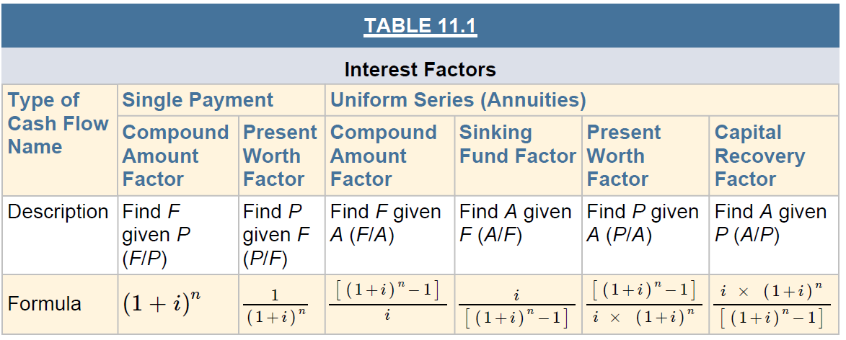
11.14 Summary of Equivalence Formulas

Slide 20
11.15 Worth Analysis Techniques: Rationale and Vocabulary
Example: $3,000 every year for the next 10 years vs. $20,000 now. MARR is 10%
Three techniques can be used:
If the present value of a $3,000 annuity over 10 years at your MARR is greater than the $20,000 that Thaddeus will borrow from you. The approach of finding the net present value of an investment is called the present worth (PW) method. 현재가치법
If the $3,000 per year is greater than the annuity resulting from investing $20,000 over 10 years at your MARR. This approach to assess the value of an investment is the equivalent worth analysis (EWA). 연등가법
If the interest that yields 10 payments of $3,000 from an initial investment of $20,000 is greater than your MARR. This approach seeks to find the implicit interest rate of an investment, which is called the internal rate of return (IRR) of the investment. 수익률법

Slide 21
11.16 Present Worth Analysis
The present worth of an investment is the sum of the present value at a given interest rate i of all amounts involved in the investment. 모든 현금흐름을 현재 시점으로 변환
Inflows (i.e., the money earned by the investor) are considered positive and outflows (i.e., the money invested) are considered negative. 현금유입은 양수, 현금유출은 음수 → 순현재등가 계산
If this sum is negative, the present value of the investment’s inflows is not enough to recover the present value of its outflows. The investment is therefore not attractive at an interest rate of i. 순현재등가 < 0 → 경제성 없음
If the sum is positive, the investment generates inflows in excess of the target interest rate of i and is attractive to the investor. 순현재등가 > 0 → 경제성 있음

Slide 22
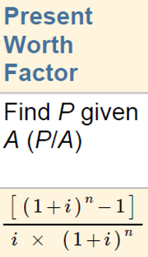
11.16.1 Example: Small Excavator
A machine will give net benefit of $5,000 for the next four years vs. Another contractor offers to purchase the machine for $15,000 now. MARR: 13.0%. 중고 기계: 지금 $15,000을 받고 팔까? vs 기계를 운용하여 향후 4년간 매년 $5,000의 이익을 실현할까?
Should he sell the machine, or keep using it for the remaining of its economic life?
Using the formula for the PW of an annuity ($5,000/year in this case) we find that: PW of $5,000 over four years at i = 13.0% = $14,872. 4년간 매년 $5,000의 이익 = 현재의 $14,872
Fudd should sell the machine, because the present value of the money that he would get by using the machine for the next four years is less than the $15,000 offered now. 파는 것이 이득

Slide 23
11.17 Equivalent Annual Worth
The Equivalent Annual Worth (EAW) of an investment is its value expressed as a uniform dollar amount over a time period. 모든 현금흐름을 연등가로 변환
More concisely, it is the equivalent annuity of an investment.
When the cost of an investment is the main issue under consideration, then the term equivalent annual cost (EAC) instead of EAW is frequently used.

Slide 24
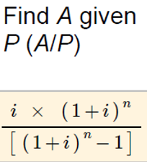
11.17.1 Example: Best Job Offer
Greg is undecided between two job offers. MARR : 12%
Fudd Associates, Inc., offers a $10,000 sign-up bonus and 계약금 $10,000, 연봉 $50,000
ABC Contractors, Inc., offers an annual salary of $54,000/year 연봉 $54,000
Based on the salary offer, which offer is better?
The question is whether the extra salary of $4,000/year offered by ABC is more attractive than the initial $10,000 bonus offered by Fudd. 계약금 $10,000 vs 연봉 차이 $4,000
The EAW for the $10,000 is the annuity resulting from P = $10,000, n = 3 years, and i = 12%. 계약금 $10,000 → 3년 동안 연봉 $4,163.5만큼의 차이에 해당
Fudd Associates, Inc. is better

Slide 25
11.18 Internal Rate of Return
The IRR of an investment is the interest rate at which the investment has a net present value of zero (i.e., PW = 0). 수익률은 순현재등가를 0으로 만들어 주는 이자율, 수익률 > MARR (최소요구수익률) → 경제성 있음
Suppose that an investment consists of the following:
Initial cost: $100,000
Net benefits: $27,057/year
Investment span: 5 years
The PW of this investment can be expressed as: PW = − 100,000 + 27,057 × (P/A, i, 5)
IRR > MARR = 10% → 경제성 있음
IRR < MARR = 12% → 경제성 없음

Slide 26
11.19 Limitations of the Internal Rate of Return Method
The IRR method has some limitations. 수익률법 단점 → 복수 대안 평가 시 사용불가 → 증분 분석 필요
This is frequently the case when there are large differences in the size of the investments. 초기 투자액에 큰 차이가 있는 경우, 현재가치법과 수익률법(증분분석을 사용하지 않고 단순히 높은 수익률의 대안을 선정하는 경우)의 결론이 달라지는 현상 발생
If we need to choose among two investments A and B, A may have the higher IRR, but B might have the larger PW of the two when computed using MARR as the interest rate. → 상호 배타적인 복수 대안 평가 시 현재가치법을 사용하는 것이 편리함

Slide 27
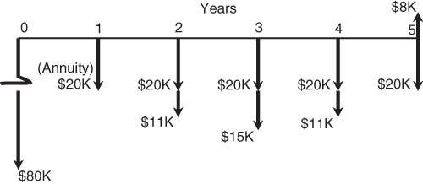
11.20 A Practical Example Using Present Worth Analysis (1/3)
Purchase of equipment, MARR of 10%.
1. Initial cost $80,000
2. Annual operational costs (operator, fuel, oil, etc.) $20,000
3. Tire replacement at the end of years 2 and 4 $11,000
4. Major overhaul at the end of year 3 $15,000
5. Sale at the end of year 5 (salvage value) $8,000
잔존가치
연간 운영비
타이어
교체비
타이어
교체비
장비
점검비
초기 투자비

Slide 28
11.20 A Practical Example Using Present Worth Analysis (2/3)
The cost of the unit—$80,000—is at present value
Therefore, A is $20,000 and P is calculated. Find P, given A : P = A(P / A, 10%, 5) = $20,000(3.7905) = $75,820
The tire replacement costs of $11,000 are assumed to occur at the end of years 2 and 4: P = F ((P / F , 10%, 2) + (P / F , 10%, 4)) = $20,000(0.8264 + 0.6830)) = $16,603
The major overhaul occurs at the end of year 3:P = F (P / F , 10%, 3) = $15,000(0.7512) = $11,200
The resale or salvage value represents revenue: P = − 8,000(P / F , 10%, 5) = − $8,000(0.6209) = − $4,967 (잔존가치 : 부의 비용)
Summation of the values calculated in (1) through (5) yields: P = $80,000 + $75,820 + $16,693 + $11,270 − $4,967 = $178,726
To find the amount that must be recovered each year from clients: A = P × (capital recovery factor) = $178,726 × (0.26380) = $47,100 적어도 매년 $47,100을 벌어들여야 함

Slide 29
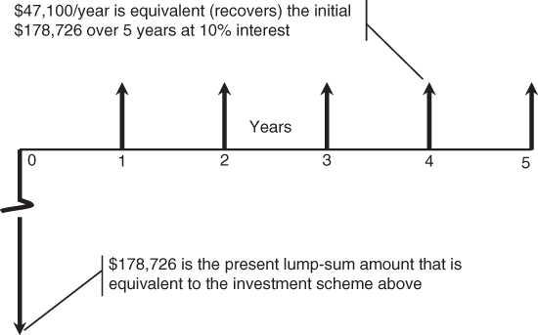
11.20 A Practical Example Using Present Worth Analysis (3/3)
장비 운용을 통한 연간 수익 : $47,100
장비 생애주기비용의 현재가치 : $178,726
FIGURE 11.5 Distribution of costs/revenue using A/P

Slide 30
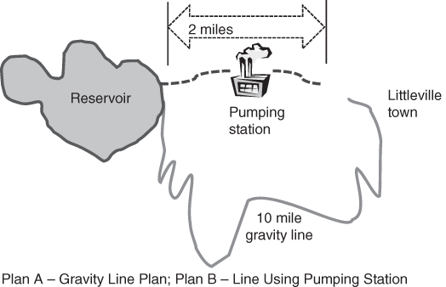
11.21 Comparison Using Equivalent Annual Worth (1/4)
상수도 건설 프로젝트 대안
B
배수지
펌핑식
A
중력식
FIGURE 11.6 Alternatives for Littleville water supply

Slide 31
11.21 Comparison Using Equivalent Annual Worth (2/4)
중력식
펌핑식
파이프라인 설치비
펌핑장 초기투자비
연간 유지보수비
10년 동안 연간 전기세
10년 이후 연간 전기세

Slide 32
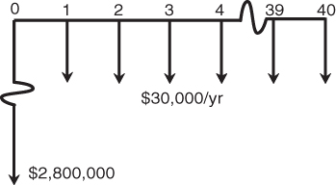
11.21 Comparison Using Equivalent Annual Worth (3/4)
P(1)
FIGURE 11.7 Cash flow for Plan A
중력식
P(2)

Slide 33
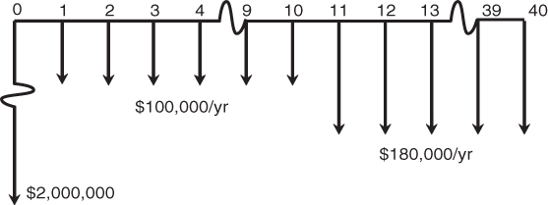
11.21 Comparison Using Equivalent Annual Worth (4/4)
중력식
펌핑식
Because $240,029 is < $287,886,
Option A is less expensive and should be selected.
중력식의 비용이 더 낮음 → 중력식 선택
P(1)
P(3)
FIGURE 11.8 Cash flow for Plan B
펌핑식
P(2)
12.409
P(4)

Slide 34
11.22 Summary
No enterprise can survive the modern business environment without a good grasp of the concepts and techniques of the time value of money. 돈의 시간적 가치를 잘 이해해야 함
Time value of money and the mathematical techniques available for considering value in various borrowing and repayment sequences are important concepts that assist construction managers as well as engineers in dealing with financial issues. 건설기술자나 건설관리자 모두 올바른 의사결정을 위해 경제성 분석 기법을 익혀야 함

