Slide 1
CHAPTER 15
EQUIPMENT PRODUCTIVITY

Slide 2
제1장 History and Basic Concepts
제2장 Preparing the Bid Package
제3장 Issues During Construction
제4장 Contracts
제5장 Legal Structure
제6장 Impact of Taxes
제7장 Project Planning
제8장 Project Scheduling
제9장 Scheduling: Program Evaluation and Review Technique Networks and Linear Operations
제10장 Resource-Related and Advanced Linear Scheduling Techniques
제11장 The Mathematics of Money
제12장 Project Cash Flow
제13장 Project Funding
제14장 Equipment Ownership
제15장 Equipment Productivity
제16장 Construction Labor
제17장 Estimating Process
제18장 Cost Control
제19장 Materials Management
제20장 Safety

Slide 3
15.1 Need for Heavy Equipment
Heavy construction equipment is needed to amplify human reach, speed, and capacity. 건설업에서는 장비로 인력 수요를 대체하는 것이 가능
The manager’s goal is to select the equipment combination that yields the maximum production at the best or most reasonable price. 최저 가격에 최대 생산성을 가진 장비 조합 결정
The cost and the rate of production combine to yield the cost per unit of production.
Cost of a particular fleet of haulers and loaders is $500 per hour → $500/hour
Production rate is 750 cubic yards per hour → 750yard³/hour
Unit price is $0.66 per cubic yard (= $500 / 750yard³)
Equipment can be classified by the nature of its work: It typically Transforms and Transports material. 변환 장비 vs 수송 장비
Construction equipment can be divided into two major categories: Productive equipment and Support equipment. 주장비 vs 지원(보조)장비
In heavy construction, large quantities of fluid or semifluid materials such as earth, concrete, and asphalt are handled and placed, leading to the use of machines. Heavy construction operations are referred to as being equipment intensive. 토목 분야 → 대규모 물량 공사 위주 (토공사, 콘크리트공사, 아스팔트포장공사 등) → 장비가 중요

Slide 4
15.2 Productivity Concepts (1/5)
The rate of output (capacity) for equipment: 작업능력 = 작업량 × 작업률 = 작업량 / 작업시간
Cyclic capacity : the number of units produced per cycle: 작업량 (한번에 처리하는 양)
Cyclic rate : speed of an equipment piece : 작업률 = 1/작업시간 (단위 시간당 처리 회수)
Different weight-to-volume ratio: three types of measure 밀도에 따라 구분
(a) bank cubic yards, (b) loose cubic yards, (c) compacted cubic yards.
Bank
Loose
Compact
같은 무게에서 부피가 30% 증가함
같은 무게에서 부피가 10% 감소함
밀도 : 보통
(2,000 / 1 = 2,000)
밀도 : 낮음
(2,000 / 1.3 = 1,538)
밀도 : 높음
(2,000 / 0.9 = 2,222)
FIGURE 15.1 Volume relationships

Slide 5
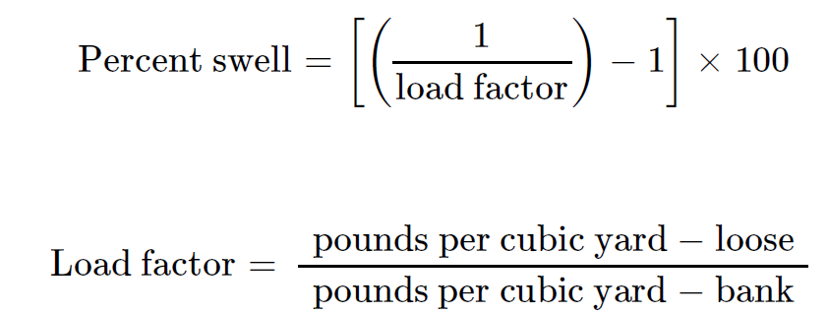
15.2 Productivity Concepts (2/5)
The relationship between the bulk or loose volume and the bank volume is defined by the percent swell. (예제: percent swell 30% → 같은 중량에 대해 부피가 30% 증가함)
The shrinkage factor relates the volume of the compacted material to the volume of the bank material. In the example, the shrinkage factor is 10% (같은 중량에 대해 부피가 10% 감소함)
Load factor = 1 → Percent swell = 0%
1,538
0.77
2,000
Load factor  → Percent swell 
Load factor  → Percent swell 

Slide 6
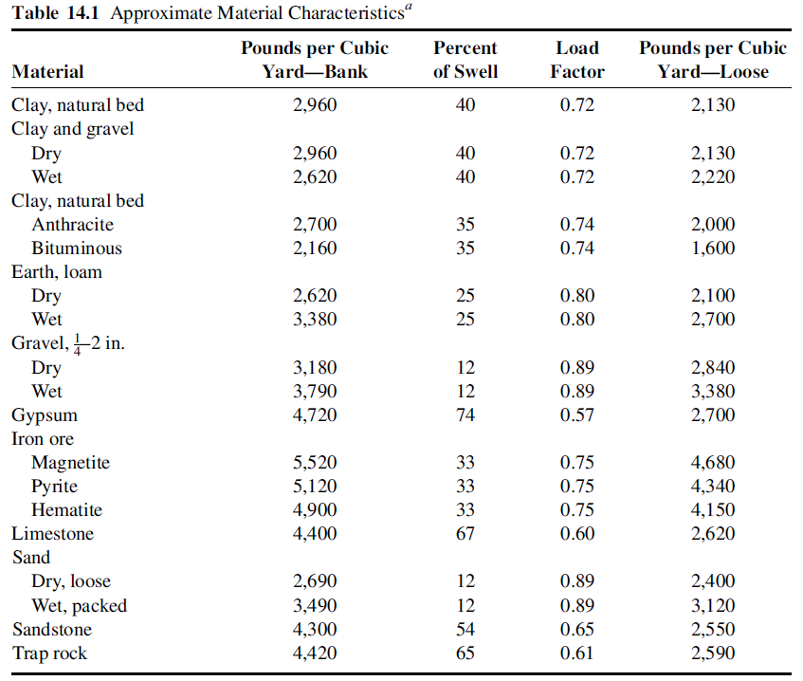
15.2 Productivity Concepts (3/5)

Slide 7
15.2 Productivity Concepts (4/5) 예제 (1/2)
A front-end loader (200 bank yd³/hour). 1 loader : 200 bank yd³/hour
It loads a fleet of four trucks (capacity 18 loose yd³ each), which haul the earth to a fill where it is compacted with a shrinkage factor of 10%. 4 trucks : 18 loose yd³
Each truck has a total cycle time of 15 min. 트럭 운송 시간 : 15분
The earth has a percent swell of 20%.
The job requires a volume of 18,000 compacted yd³. 총 작업량 : 18,000 compacted yd³
How many hours will be required to excavate and haul the material to the fill? 총 작업 소요 시간?
Then the loader productivity (given 20% swell) is:
The truck fleet production is:
병목장비: 생산용량을 제약하는 장비

Slide 8
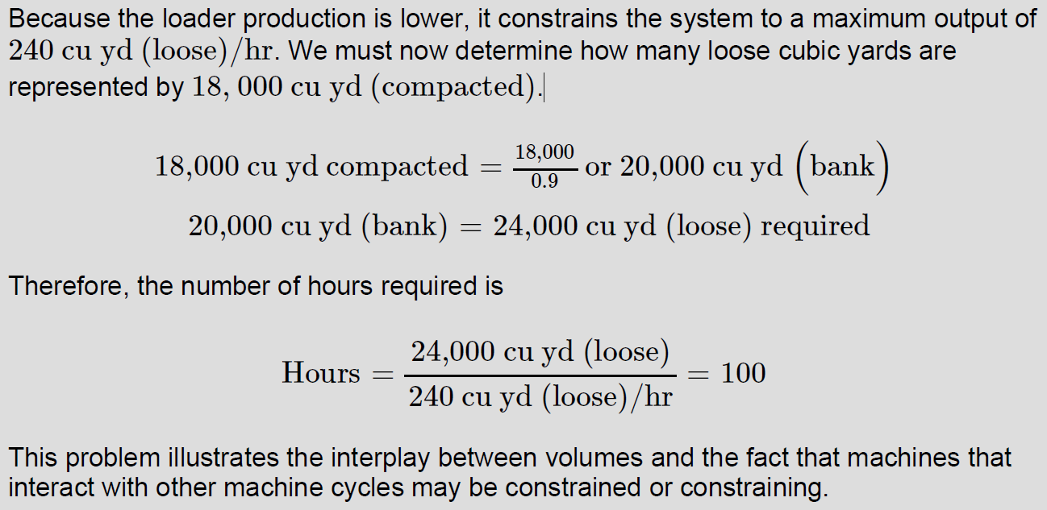
15.2 Productivity Concepts (5/5) 예제 (2/2)
shrinkage factor : 10%
Compacted → Bank
Bank → Loose
percent swell of 20%

Slide 9
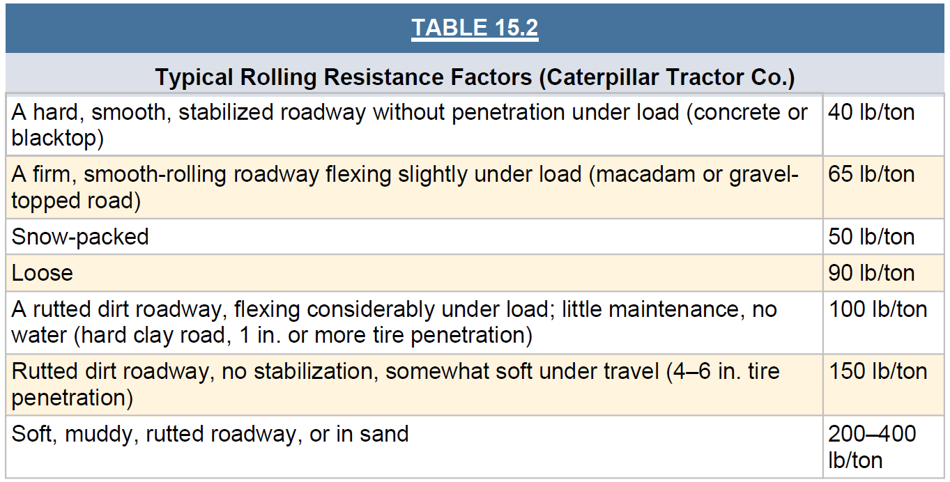
15.3 Cycle Time and Power Requirements (1/4)
In the case of heavy equipment, the speed of the machine is governed by : 장비 속도 결정 요인
(a) the power required 요구 출력
(b) the power available 가용 출력
(c) the usable portion of the power available 유효 가용 출력
요구 출력 결정 요인 : rolling resistance (RR; 회전저항) & grade resistance (GR; 경사저항)
노면 상태가 무를수록 더 큰 힘이 필요함

Slide 10
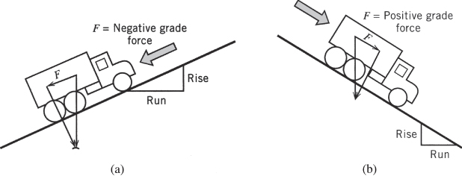
15.3 Cycle Time and Power Requirements (2/4)
내부 마찰
찌글어듬
파묻힘
적재 하중
FIGURE 15.2 Factors influencing rolling resistance
(4개 요인 → 회전저항의 크기 결정 )
(노면 경사 → 경사저항의 크기 결정 )
오르막에서
더 큰 힘이 필요함
FIGURE 15.3 Grade resistance: (a) negative (resisting) force and (b) positive (aiding) force

Slide 11
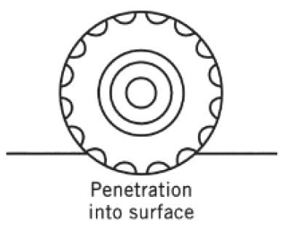
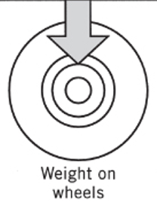
15.3 Cycle Time and Power Requirements (3/4)
2 inches
회전저항은 바퀴가 잠기는 높이에 비례
The rule of thumb states that the RR is approximately 40 lbs/ton plus 30 lbs/ton for each inch of penetration of the surface under wheeled traffic.
If the estimated deflection is 2 inches and the weight on the wheels of a hauler is 70 tons, we can calculate the approximate RR as:
RR = [40 + 2(30)] lb/ton × 70 tons = 7,000 lb
A slope rises 6 feet in 100 feet of horizontal distance, the percent grade is 6. 경사 : 6%
Percent grade is used to calculate the GR using the following relationship:
GR = percent grade × 20 lb/(ton × % grade) × weight on wheels(tons)
GR = 6% grade × 20 lb/(ton × % grade) × 70 tons = 8,400 lb
Power required = RR + GR = 7,000 lb + 8,400 lb = 15,400 lb ← 오르막
Power required = RR − GR = 7,000 lb − 8,400 lb = − 1,400 lb ← 내리막

Slide 12
15.3 Cycle Time and Power Requirements (4/4)
70 tons
경사 저항
회전 저항
GR = # % grade × 20 lb/(ton × % grade) × 70 tons
RR = # lb/ton × 70 tons

Slide 13
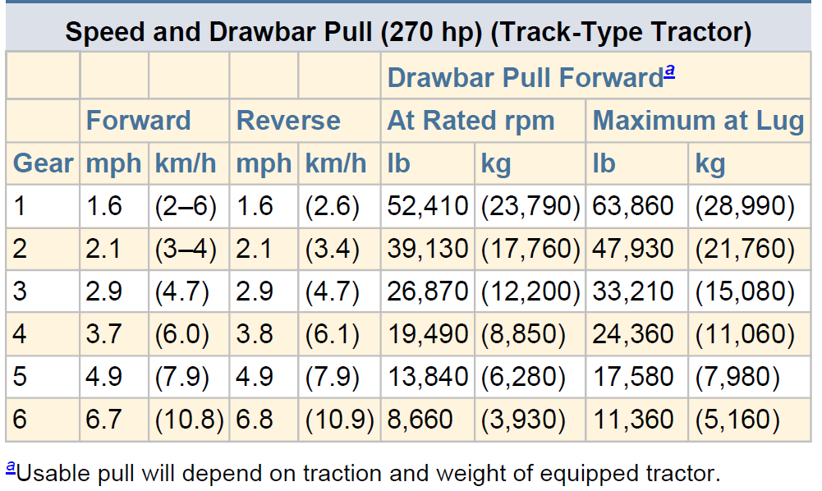
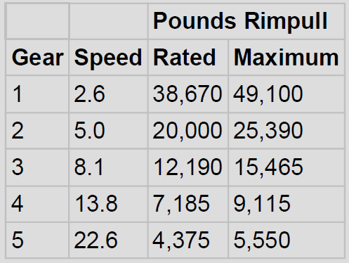
15.4 Power Available (1/3) 가용 출력
The power available is controlled by the engine size of the equipment and the drive train (동력 전달축). 가용 출력 결정 요인 : 엔진 크기, 기어 비율
기어
전진속도
후진속도
정상출력
최대출력
10,000 lb의 출력이 필요할 때 최대 가능 속도는?

Slide 14
15.4 Power Available (2/3)
회전저항을 경사저항으로 변환하는 식
+70,000 lb
→ 2,500 lb, 41 mph
→ 5,500 lb, 19 mph
Loaded
126,000 lb
①
Empty
56,000 lb
35-ton, off-highway truck
경로 선택 문제
경로 #1:
4.6 miles (24,344 feet)
RR = 50lb/ton
경로 #2:
2.8 miles (14,784 feet)
RR = 90lb/ton
소요
구동력
4.5%
①
③
5,500 lb
2.5%
2,500 lb
②
19 mph
④
41 mph
④
최대 속도
FIGURE 15.5 Gear requirements chart for 35-ton off-highway truck (Caterpillar Tractor Co.)

Slide 15
15.4 Power Available (3/3)
빈 차
To break the 24,344 into two segments: 9.51분
(a) 16,000 ft : 7.2분
(b) 잔여 8,344 ft : 2.31분 (최대 속도 운행 가정)
= [8,344 ft / (41 mi/h × 5,280 ft/mi)] × 60 min
운송 시간 추정
경로 #1: 9.51분
경로 #2: 9.5분
두 경로 모두 9.5분으로 동일한 운송시간 소요 → 다른 요인을 고려하여 결정
짐을 실은 차
4.5%
9.5분
7.2분
2.5%
14,784 feet
FIGURE 15.6 Travel time: (a) empty and (b) loaded (Caterpillar Tractor Co.)

Slide 16
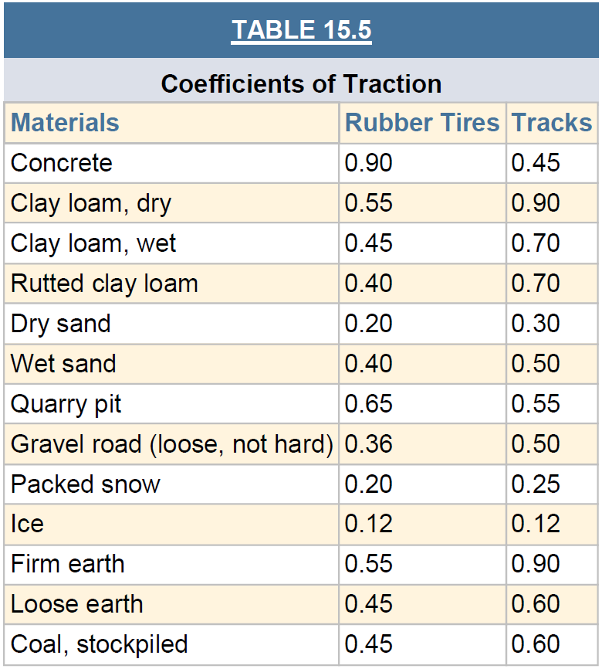
15.5 Usable Power (1/4) 유효 가용 출력
Typical values for rubber-tired and tracked vehicles on an assortment of surface materials. 견인력 계수는 노면 종류에 따라 결정됨
견인력 계수
Usable pounds pull
= (coefficient of traction) × (weight on drivers)
물 뿌리기

Slide 17
15.5 Usable Power (2/4)
Usable pounds pull = (coefficient of traction) × (weight on drivers)
Driver
Driver
Driver
FIGURE 15.7 Determination of driver weights

Slide 18
15.5 Usable Power (3/4)
High RR of the sand (RR = 400 lb/ton), 26-ton loads
The weight distribution characteristics of the 30-yard tractor-scraper are as follows:
The difference between the total weight empty and loaded is 72,000 pounds, or 36 tons. The loaded weight with 26-ton loads would be 127,800 pounds.
공차 중량 분포
적재 시 중량 분포
차이 = 147,800 – 75,800 = 72,000 pound = 36 ton (최대 적재량)
75,800 pound + 26 ton × 2000 pound/ton = 127,800 pound
필요 출력
마른 모래
제공 출력
63.9 ton
젖은 모래
제공 출력
현장에 물을 뿌림으로써 필요 출력을 제공할 수 있음

Slide 19
15.5 Usable Power (4/4)
고산지대의 경우,
산소 부족으로 출력 감소 현상 발생
Decrease pounds pull 3% for each 1,000 feet (above 3,000 feet).
If a tractor is operating at 5,000 feet above sea level, its power will be decreased by 6%.
Usable pound pull 유효 가용 출력
사용 가능 범위
요구 출력
FIGURE 15.8 Impact of usable power constraints

Slide 20
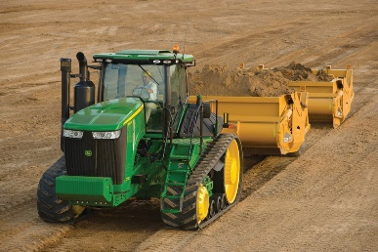
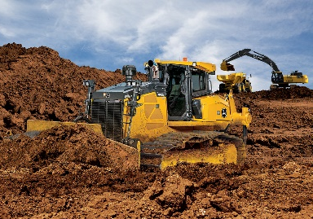
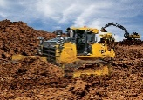
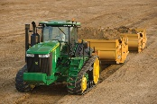
15.6 Equipment Balance (1/5)
Two types of equipment work together: a 30 cubic yard scraper & a 385-horsepower pusher dozer
3,000-feet
빈차 (1.2분)
싣고
3,000-feet
내리고
만차 (1.4분)
FIGURE 15.9 Scraper-pusher dual-cycle model

Slide 21
15.6 Equipment Balance (2/5)
Assume that in this case the 30-cubic yard tractor Scraper is carrying rated capacity and operating on a 3,000-foot level haul road where the RR developed by the road surface is 40
lb/ton.
Effective grade 회전저항 → 경사저항
= (RR)/(20 lb/ton/% grade)
= (40 lb/ton)/(20 lb/ton/% grade) = 2%
Pusher
Load time = 0.70
Boost time = 0.15
Transfer time = 0.10
Return time = 0.28
Total = 1.23 minutes
2%
(만차 : 1.4분)
2%
(공차 : 1.2분)
FIGURE 15.10 Travel time nomographs (Caterpillar Tractor Co.)

Slide 22
15.6 Equipment Balance (3/5)
흙을 운반하는 사이클 = 4.05분
흙을 싣는 사이클 = 1.23분
FIGURE 15.11 Scraper-pusher cycle times

Slide 23
15.6 Equipment Balance (4/5)
Scraper 5대
생산성
손실
= 1,463.4 / 444.4
Scraper 3대
생산성
손실
Scraper 2대
Scraper 1대
FIGURE 15.12 Productivity plot

Slide 24
15.6 Equipment Balance (5/5)
회전저항
경사저항
총 저항
적재량
기어 비율 속도/출력 차트
속도
수송 거리
주기 시간
가용 출력
운영 효율
생산성
토량변화율
수송 적재량
장비 대수
FIGURE 15.13 Flow of equipment operations calculation

Slide 25
15.7 Random Work Task Durations (1/3)
The influence of random durations on the scraper fleet production: the reduction in production caused by the addition of random variation of cycle activity times. 작업시간 변동성 → 생산성 하락 요인
1,333.3
변동성 無
생산성
생산성
손실
변동성 有
운반 장비 대수
FIGURE 15.14 Productivity curve to include the effect of random cycle times

Slide 26
15.7 Random Work Task Durations (2/3)
3대의 Scraper가 동일 간격으로 움직이고 있어야하나, Random한 요소로 인해 간격이 달라지면 Pusher에 Idle Time이 발생함 → 생산성 저하 발생
Scraper 1
Scraper 2
Pusher
Scraper 3
FIGURE 15.15 Comparison of haul unit cycles

Slide 27
15.7 Random Work Task Durations (3/3)
Coefficient Of Variation (COV) : 변동계수 또는 변이계수 = 표준편차 / 평균 → 평균 대비 표준편차의 크기
운송시간 Lognormal
분포 가정
COV 변동성이 0.1일 때,
10% 생산성 저하
FIGURE 15.16 Plot of cycle time coefficient of variation

